Slide 1
Data flow based Testing

Slide 2
Data flow based Testing
Definition:-Uses the control flow graph to explore the unreasonable things that can happen to data (data flow anomalies).
Data flow anomalies:-
Variables are used without being initialized.
Initialized variables are not used once.

Slide 3
Definition (def) and Use(use)
An occurrence of a variable in the program is a definition of the variable if a value is bound to the variable at that occurrence.
def(S) = {X /statement S contains a definition of X }.
1
read (x, y)
2
z = x + 2
3
z < y
An occurrence of a variable in the program is a use of the variable if the value of the variable is referred at that occurrence.
use(S) = {X /statement S contains a use of X }
T
4
F
5
w = x + 1
y = y + 1
6
print (x,y,w,z)

Slide 4
Predicate Uses and Computation Uses
A use of a variable is a predicate use (p-use) if the variable is in a predicate and its value is used to decide an execution path.
A use of a variable is a computation use (c-use) if the value of the variable is used to compute a value for defining another variable or as an output value.

Slide 5
Example
1. read (x, y);
2. z = x + 2;
3. if (z < y)
4 w = x + 1;
else
5. y = y + 1;
6. print (x, y, w, z);
Definition | c Use | p use
x | x
y | y | Y
z | z | Z
w | w

Slide 6
Definition Clear Paths
A path (i, n₁ , n₂ , …, n_{m}, j) is a definition-clear path for a variable x from i to j if n₁ through n_{m} do not contain a definition of x.
The family of data flow criteria requires that the test data execute definition-clear paths from each node containing a definition of a variable to specified nodes containing c-use and edges containing p-use of that variable.

Slide 7
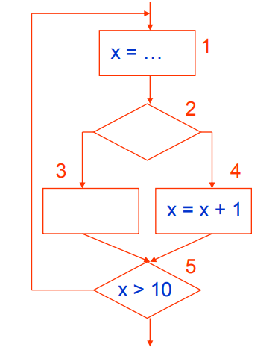
Definition Clear Paths
Example 1: (1, 2, 4)
Example 2:(1, 2, 3, 5)

Slide 8
Definition Clear Paths
1. read (x, y);
2. z = x + 2;
3. if (z < y)
4 w = x + 1;
else
5. y = y + 1;
6. print (x, y, w, z);
1
read (x, y)
2
z = x + 2
3
z < y
T
4
F
5
w = x + 1
y = y + 1
e.g. definition-clear path of Z from 1 to 6 is
1,2, 3,4,6 or 1,2, 3,5,6
6
print (x,y,w,z)

Slide 9
def-use association
A def-use association is a triple (x, d, u,), where:
x is a variable,
d is a node containing a definition of x
u is either a statement or predicate node containing a use of x, and there is a sub-path in the flow graph from d to u with no other definition of x between d and u.

Slide 10
Example
Some def-use Associations:
(x, 1, 2), (x, 1, 4), …
(y, 1, (3,t)), (y, 1, (3,f)), (y, 1, 5), …
(z, 2, (3,t)),...
1
read (x, y)
2
z = x + 2
3
z < y
T
4
F
5
w = x + 1
y = y + 1
6
print (x,y,w,z)

Slide 11
du path
A path (n₁ , n₂ , …, n_{m}) is a du path for variable x if n₁ contains a definition of x and either n_{m} has a c-use of x and (n₁ , n₂ , …, n_{m}) is a definition-clear path for x (all nodes, except possibly n₁ and n_{m}, are distinct) or is a p-use of x and is a definition-clear loop free path for x (all nodes are distinct) .
e.g. (1, 2, 4)
(1, 2, 3, 5)

Slide 12
1
read (x, y)
i = 1
What are all the du-paths in the following program ?
read (x,y);
for (i = 1; i <= 2; i++)
print (“hello”);
Sa;
if (y < 0)
Sb;
else
print (x);
2
3
i <= 2
T
4
F
5
print(“hello”) i = i + 1
S_{a}
6
y < o
T
F
S_{b}
7
8
print x
9

Slide 13
Exercise
What are all the def-use associations for the program below?
read (z) x = 0
y = 0
if (z ≥ 0)
{
x = sqrt (z)
if (0 ≤ x && x ≤ 5)
y = f (x)
else
y = h (z)
}
y = g (x, y)
print (y)

Slide 14
Exercise
/* pow(x,y)
This program computes x to the power of y, where x and y are integers. INPUT: The x and y values.
OUTPUT: x raised to the power of y is printed to stdout.
void pow (int x, y)
{
float z; int p;
if (y < 0)
p = 0 – y; else p = y;
z = 1.0;
while (p != 0)
10 {
11 z = z * x;
12 p = p – 1;
13 }
14 if (y < 0)
15 z = 1.0 / z;
16 printf(z);
17 }
*/ 1
2
3
4
5
6
7
8
9

Slide 15
Strategies(Cont’d)
All-c-uses coverage
All-p-uses coverage
All-uses coverage
All-du-paths coverage
All-defs coverage

Slide 16
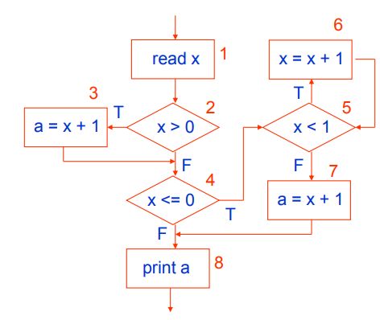
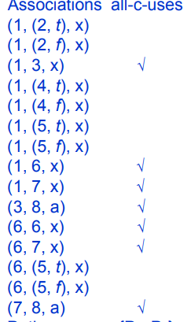
Strategies
All c-use coverage :-
Test cases include a definition-clear path from every definition to some corresponding c-use.

Slide 17
Strategies
All-defs coverage :-
Test cases include a definition-clear path from every definition to some corresponding use (c-use or p-use).

